Slide 1
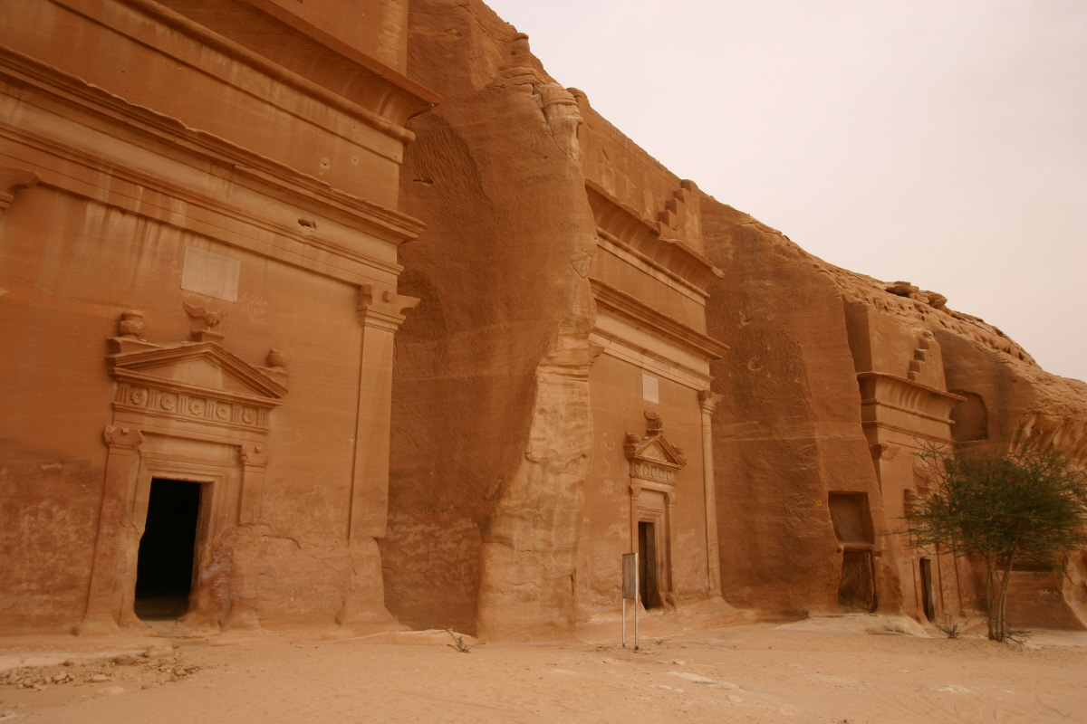
Daily Life in Early Arabia

Slide 2
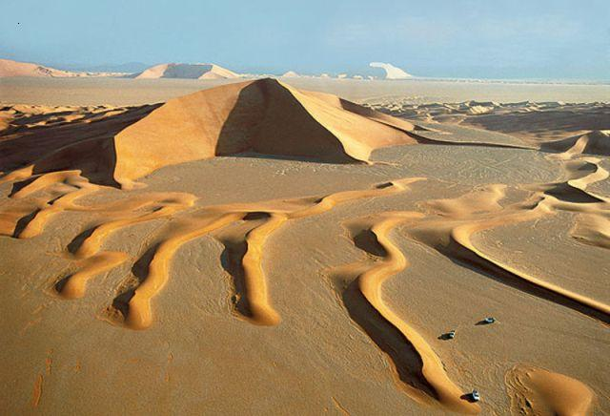
Daily life in Early Arabia
Main Idea (Objective):
The deserts, coastline and oases of Arabia helped shape the Arab way of life.

Slide 3
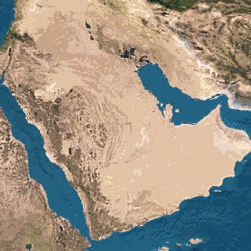
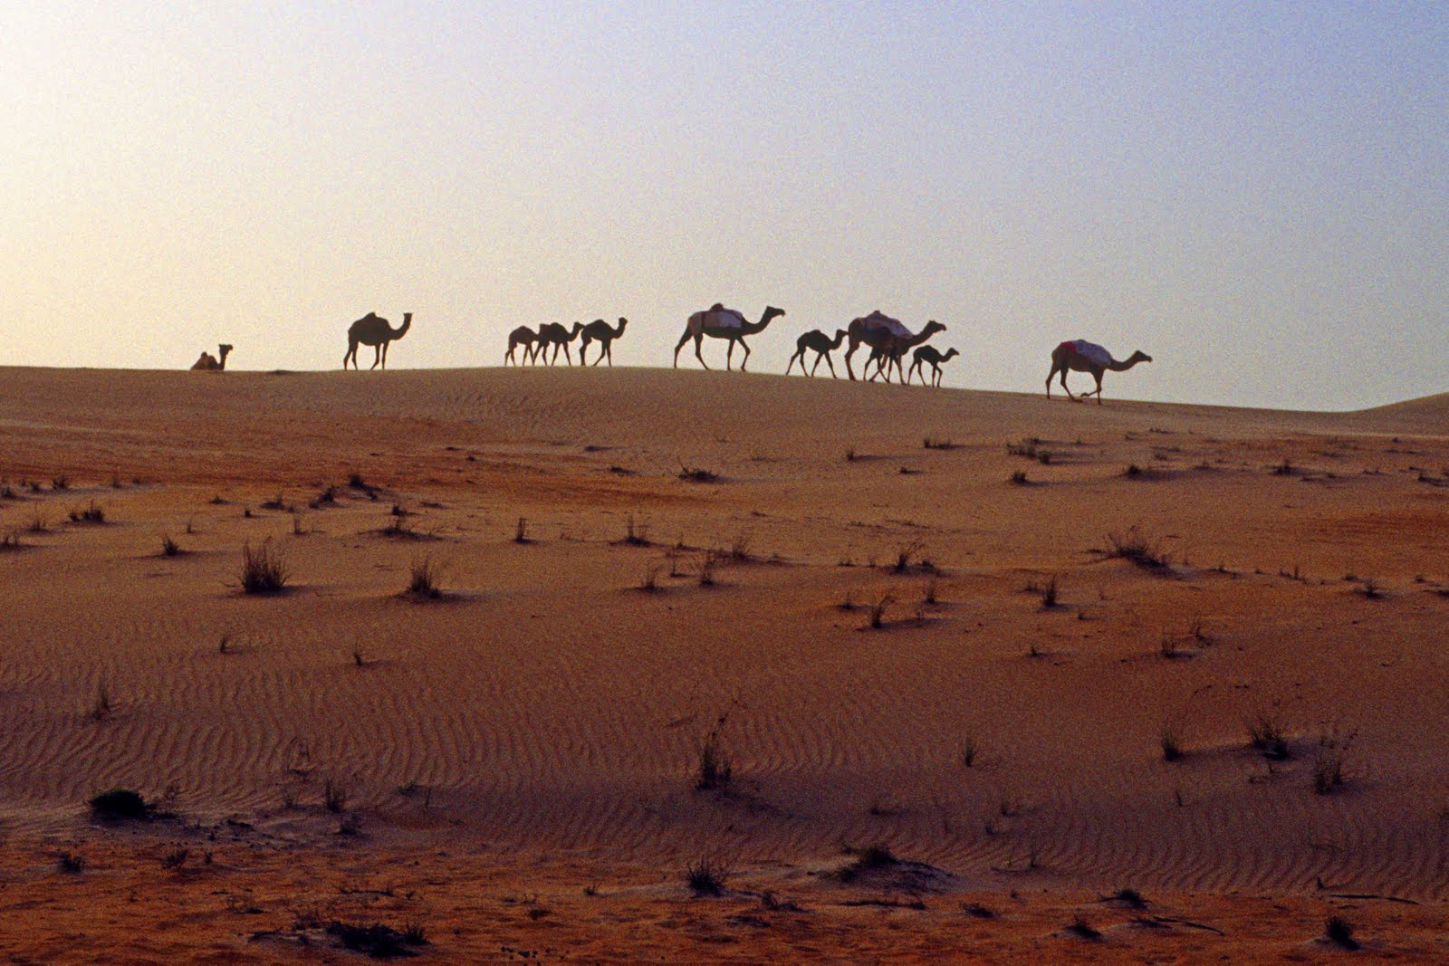
Daily life in Early Arabia
Desert stretches over most of the Arabian peninsula.
The heat is intense and travelers are at the whim of blinding sandstorms.

Slide 4
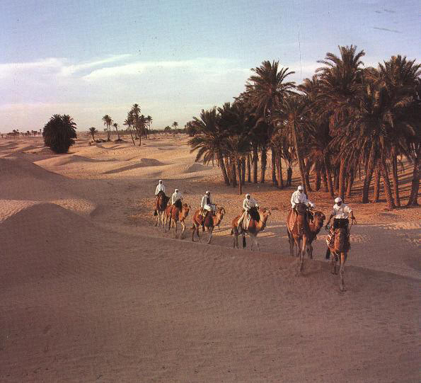
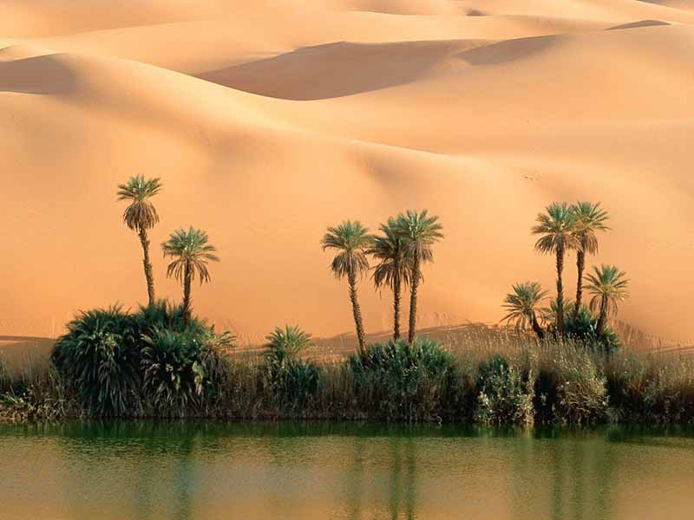
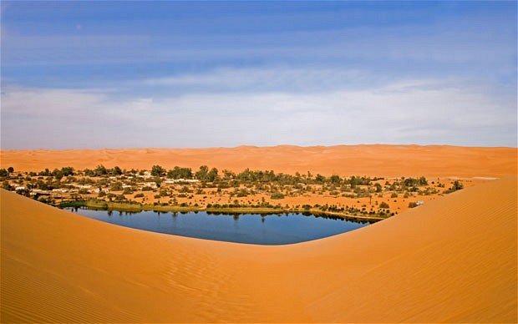
Daily life in Early Arabia
Water is only found at Oases…green areas fed by underground water.

Slide 5
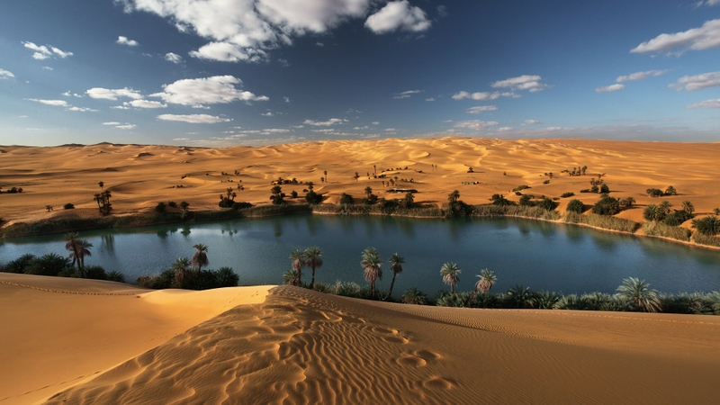
Daily life in Early Arabia

Slide 6
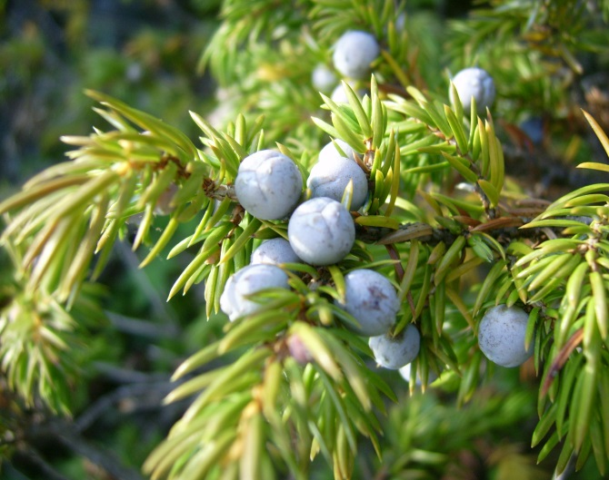
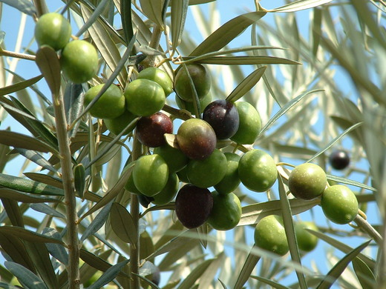
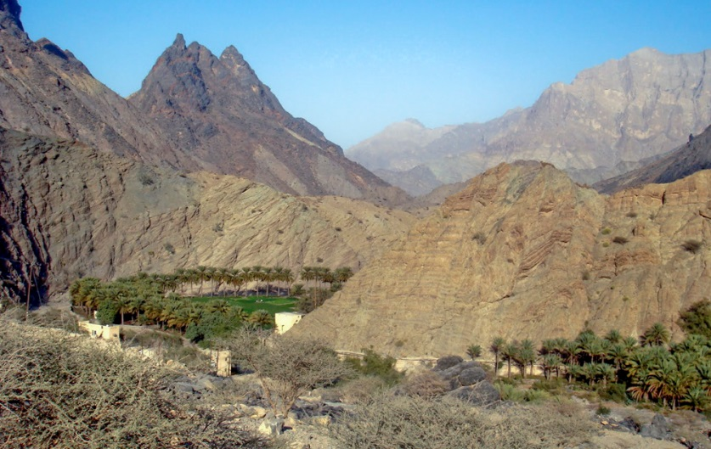
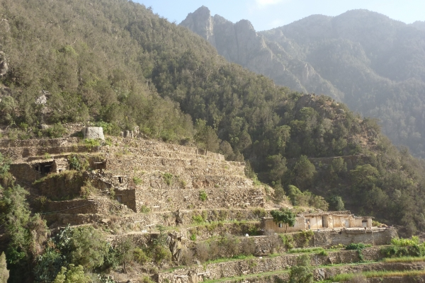
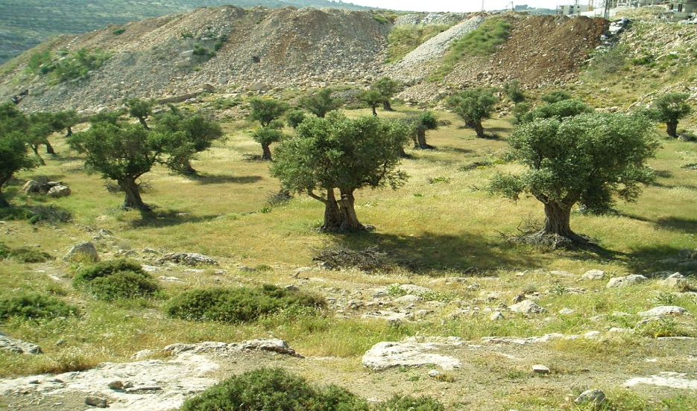
Daily life in Early Arabia
Not all of Arabia is dry, however…
In the mountains of the southwest, enough rain falls to support plants such as juniper and olive trees.

Slide 7
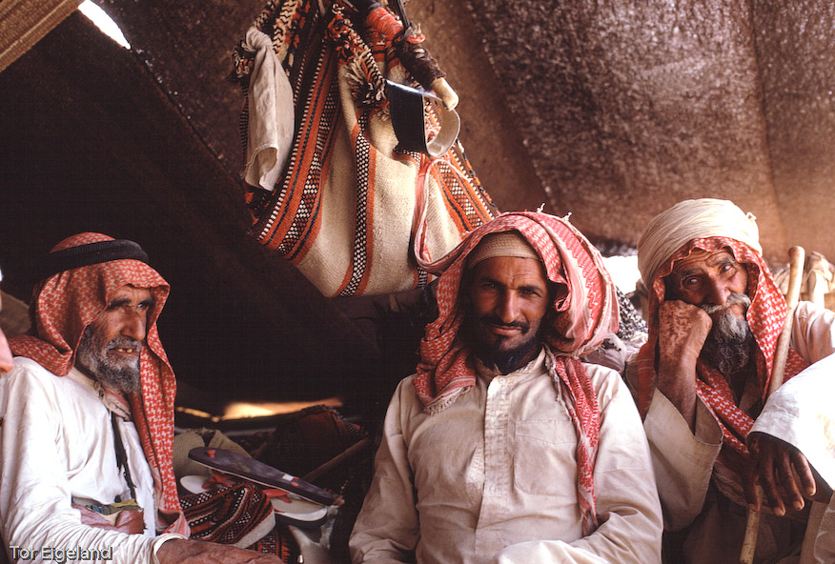
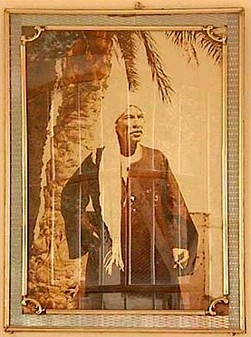
Daily life in Early Arabia
To survive this harsh environment, Arabs formed into clans…which are groups of people related by family ties and who are completely loyal to each other.
The tribes leaders were called a Sheikh.

Slide 8
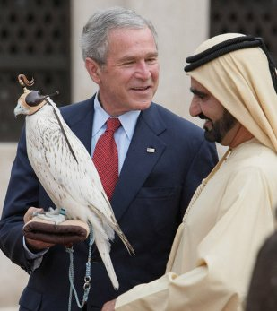
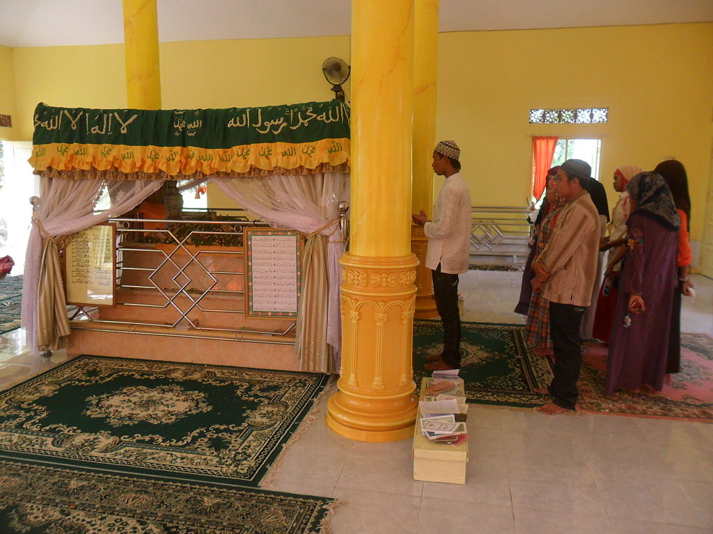
Daily life in Early Arabia
In todays Arab world the term Sheikh is used to describe someone who is royalty, or basically people of imperial blood or status within a country. (Tomb from Sheikh Abdul Hamid in West Martapura, Indonesia.)

Slide 9
Daily life in Early Arabia
Questions:
1) What is a Oases?
A green area that can be found in the middle of a desert.
2) How are these Oases able to survive?
They are fed by ground water

Slide 10
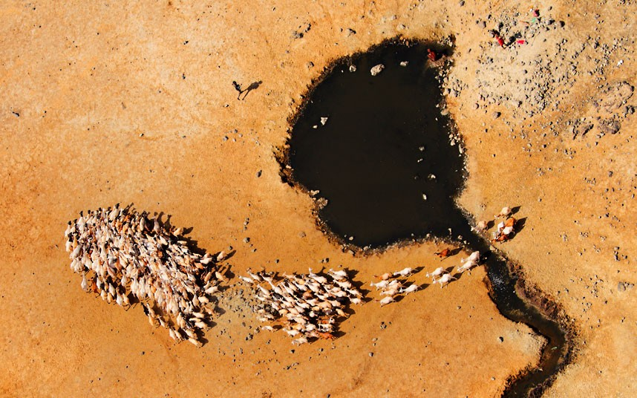
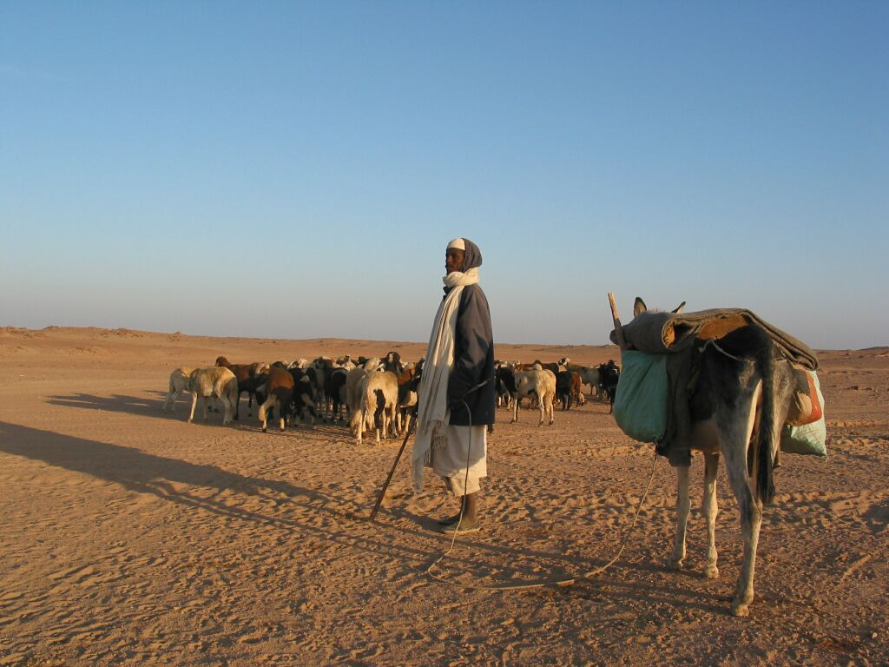
Who are the Bedouins?
Some Arabs were desert herders…to water and graze their camels, goats and sheep, they traveled from oasis to oasis.
These herders were called Bedouins( Bed-oo-win).

Slide 11
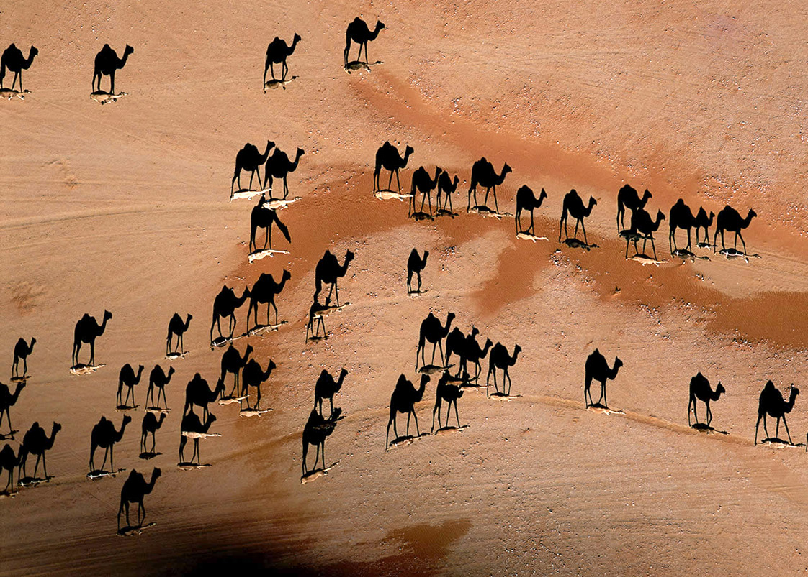
Who are the Bedouins?

Slide 12
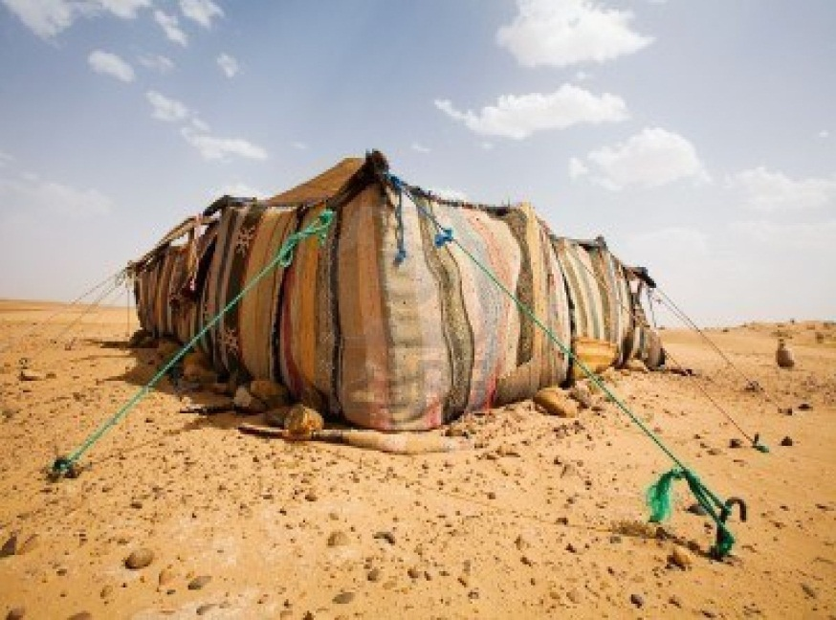
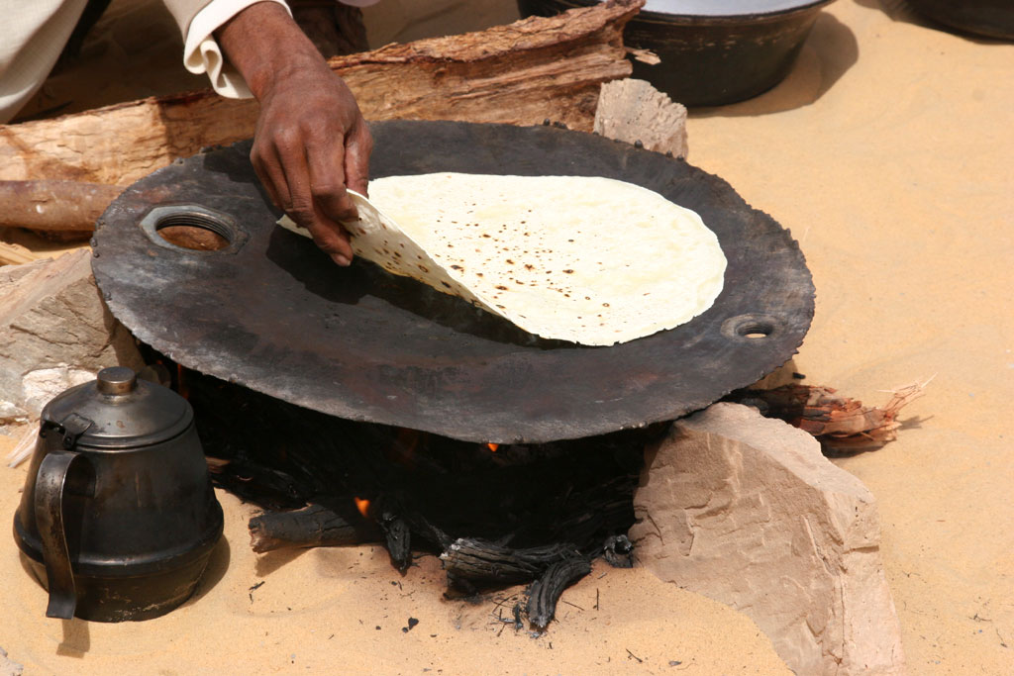
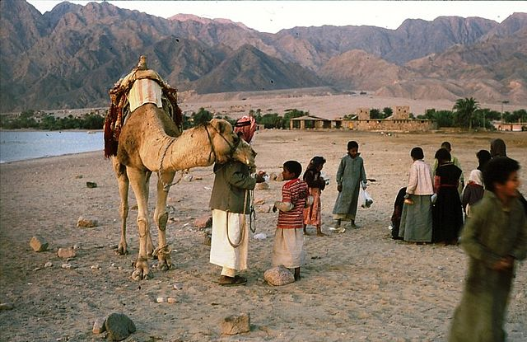
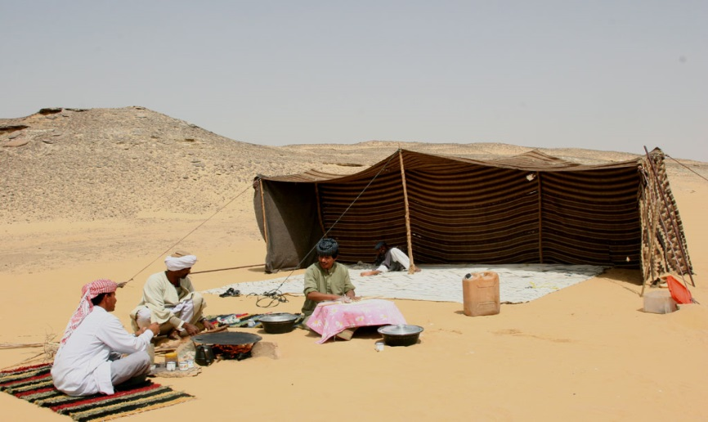
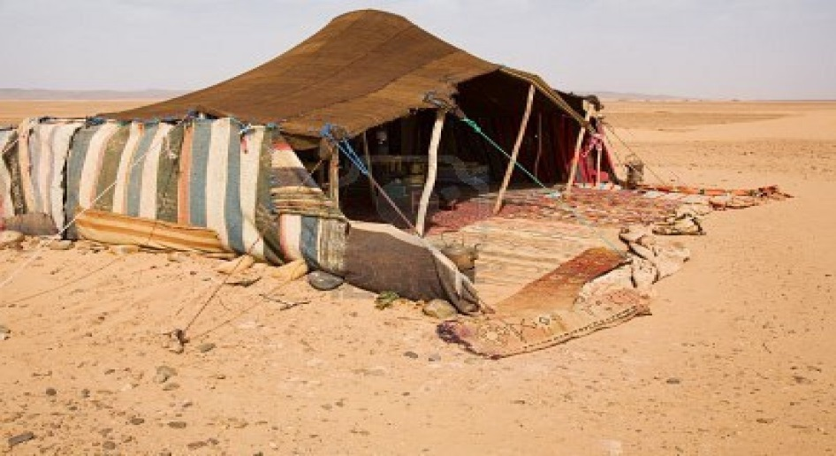
Who are the Bedouins?
Today, many Bedouins still roam the desert and live in tents.

Slide 13
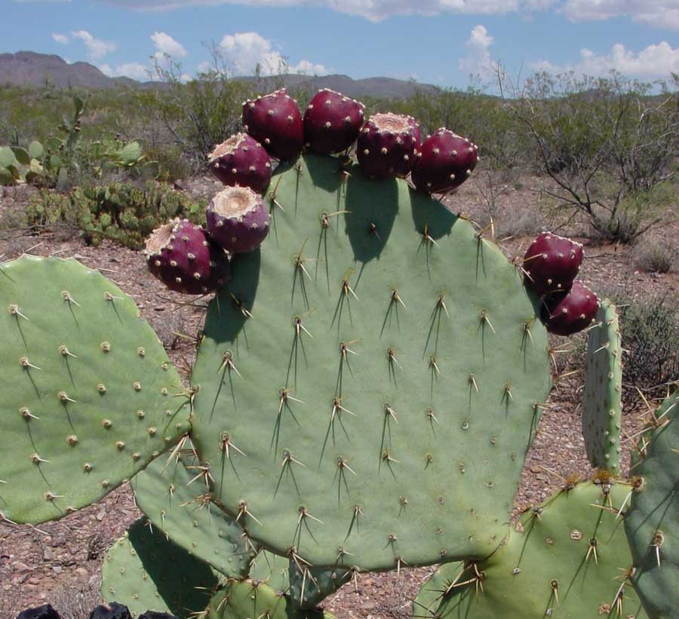
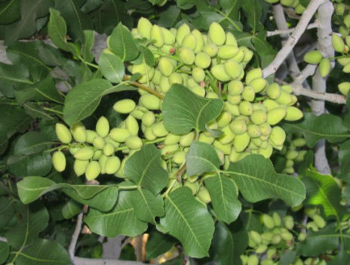
Who are the Bedouins?
Bedouins in the past lived in tents and ate what they could forage…dried fruits and nuts. They also drank the milk of their animals.
Only rarely would they eat meat…their animals were much too valuable to be used as food.

Slide 14
Who are the Bedouins?
Questions:
1) What is a herder?
A person who raises animals for a living
2) Why do you think a herder’s animals are more valuable alive then used as food?
Answers will vary…

Slide 15
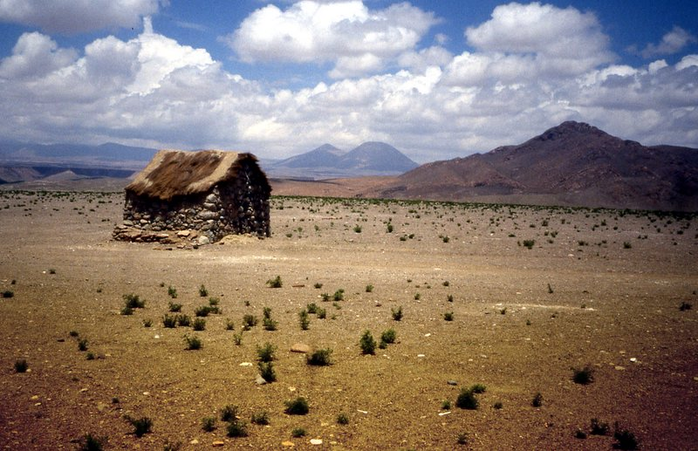
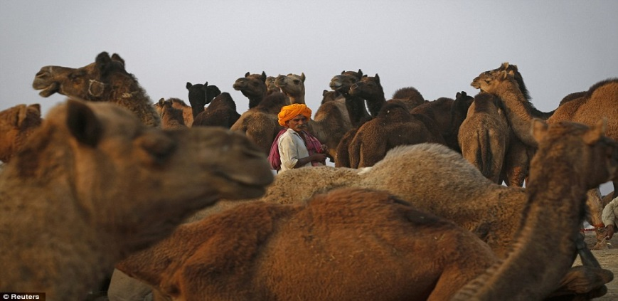
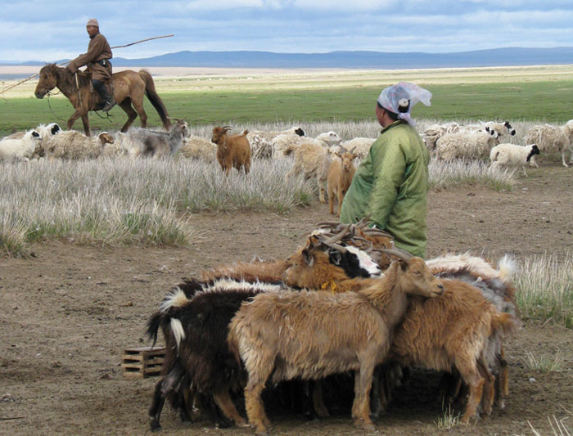
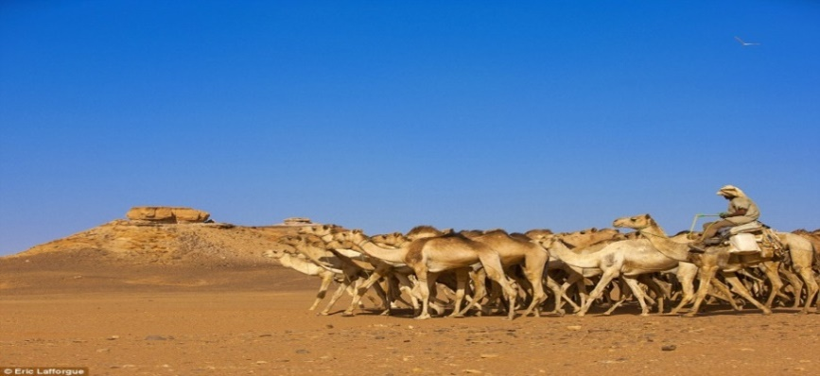
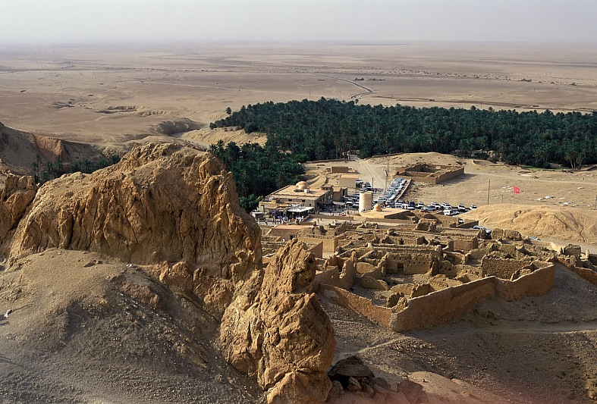
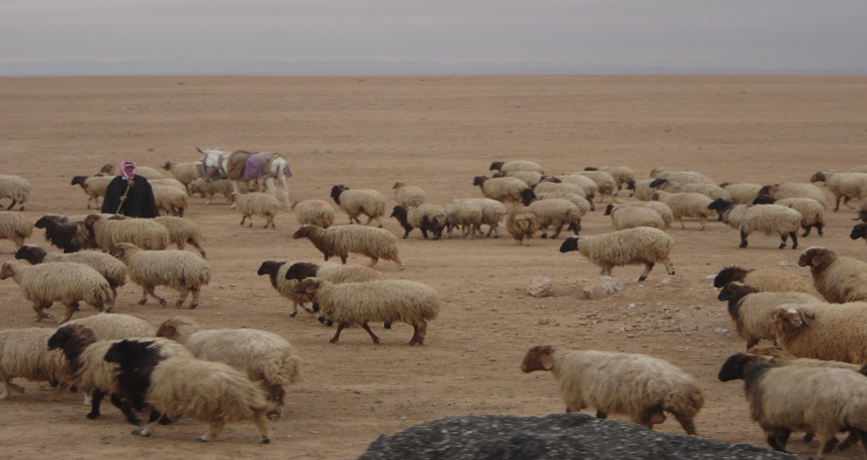
Trade and Towns
Many Arabs lived in villages where they farmed or raised animals.
These villages were located near Oases or in the northern mountain ranges.

Slide 16
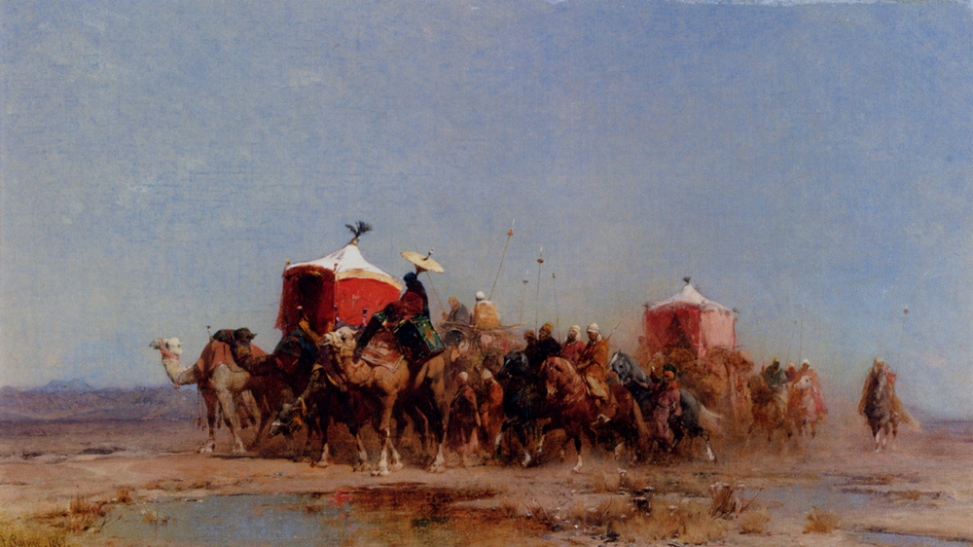
Trade and Towns
Some of the villagers were merchants who transported goods across the desert.
To fend off attacks by Bedouins, many Arabs traveled in a Caravan.

Slide 17
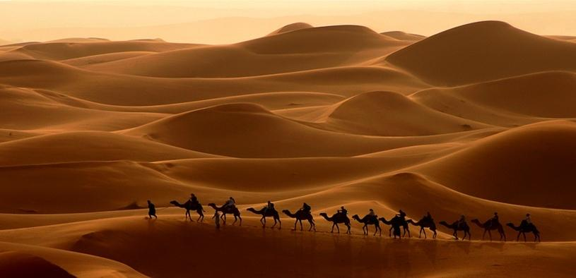
Trade and Towns
Caravan - a group of traveling merchants and animals

Slide 18
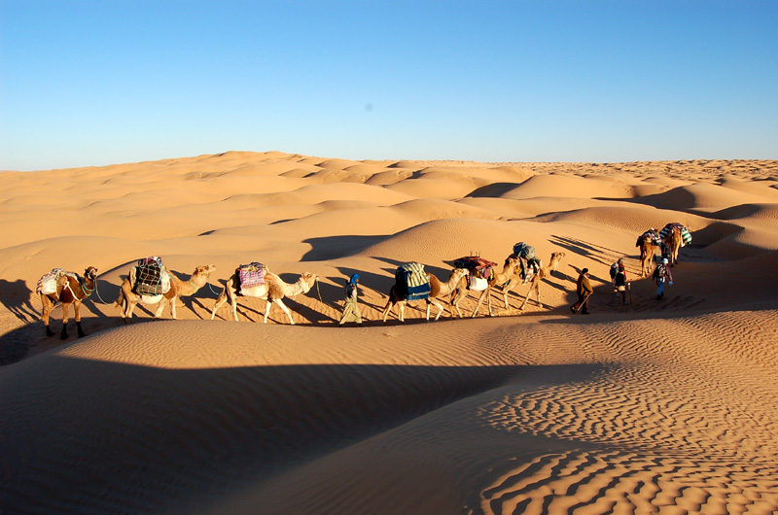
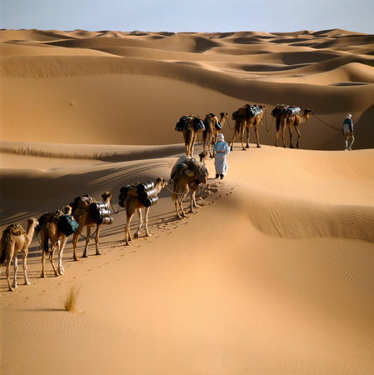
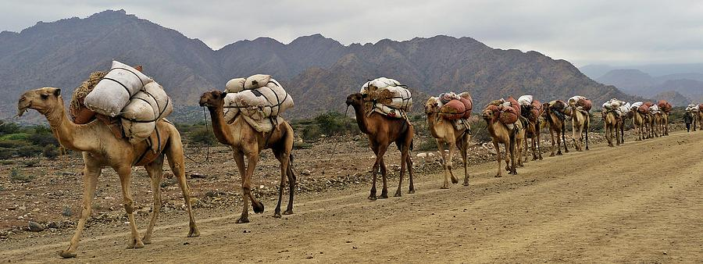
Trade and Towns

Slide 19
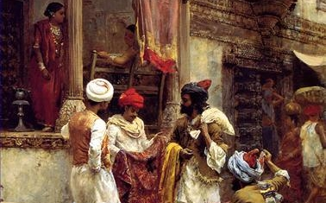
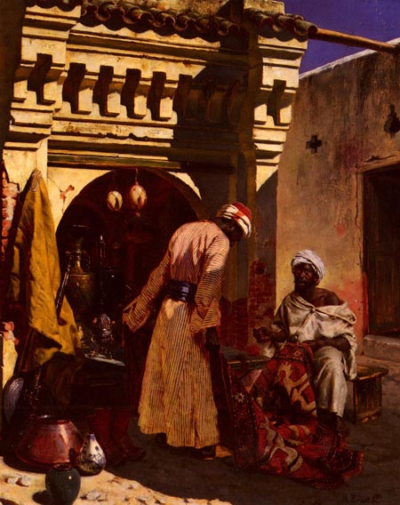
Trade and Towns
By about 500 C.E., Arabian merchants handled most trade between India and the Mediterranean Sea.
As their trade grew, Arab merchants founded towns along their trade routes in Arabia.

Slide 20
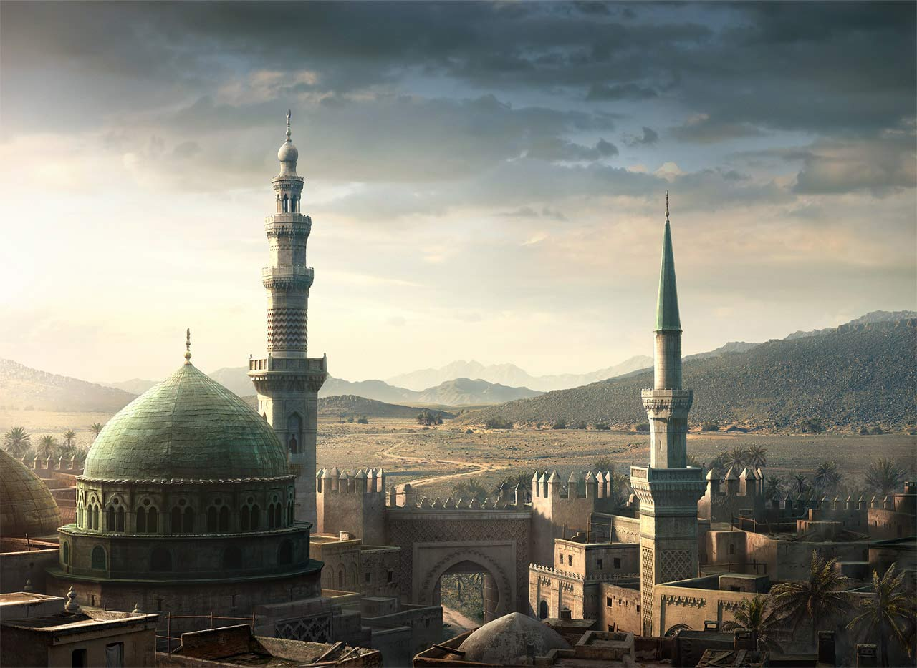
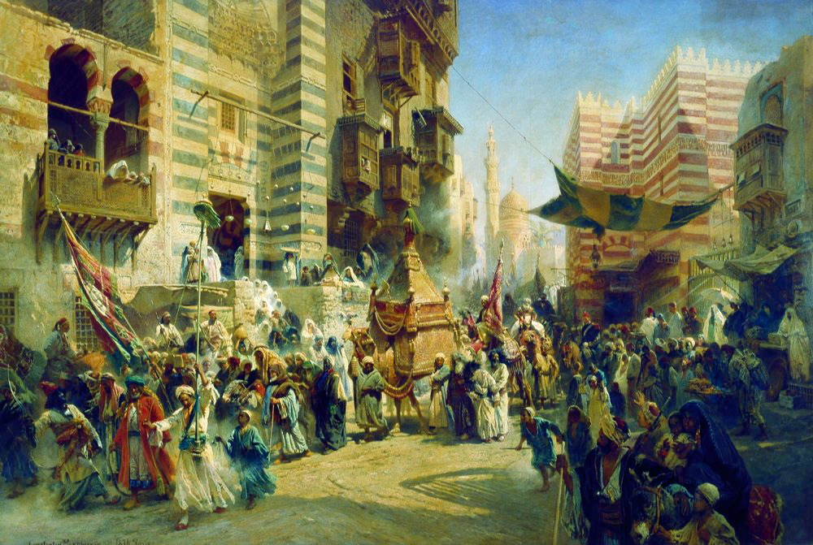
Trade and Towns
Makkah, also known as Mecca, became the largest and richest of the established towns.
Mecca was a crossroads for merchants and also became an extremely important religious site…today its located in Saudi Arabia

Slide 21
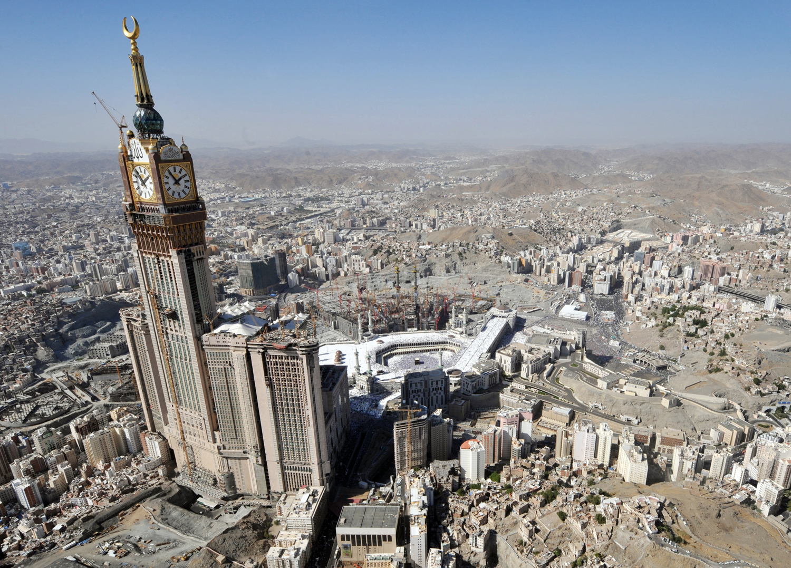
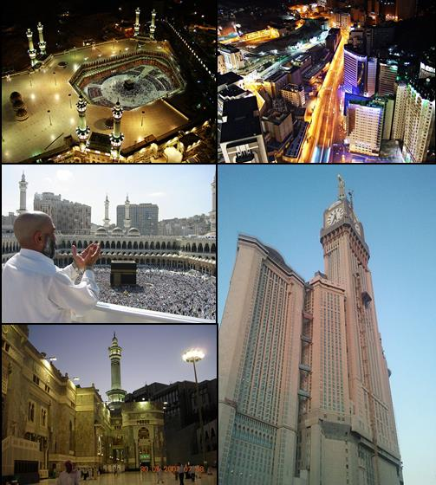
Trade and Towns
Mecca became the holiest city in Arabia, holding within its walls the sacred place in the Islamic Religion.

Slide 22
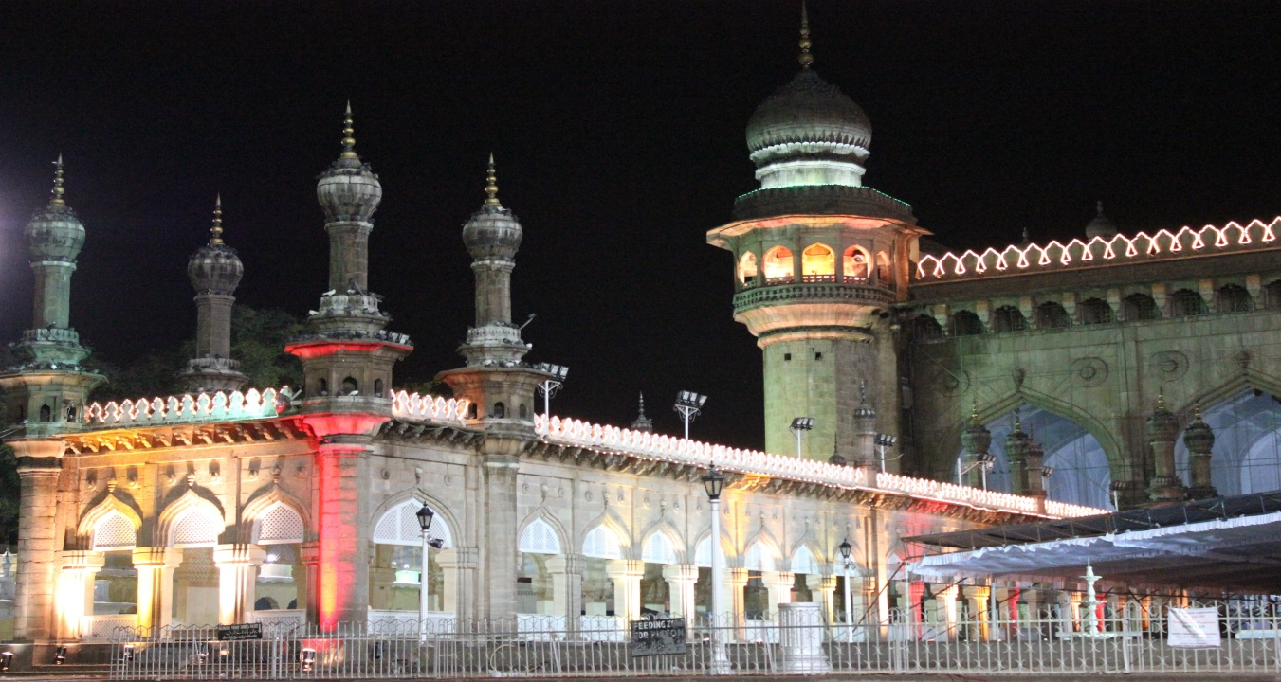
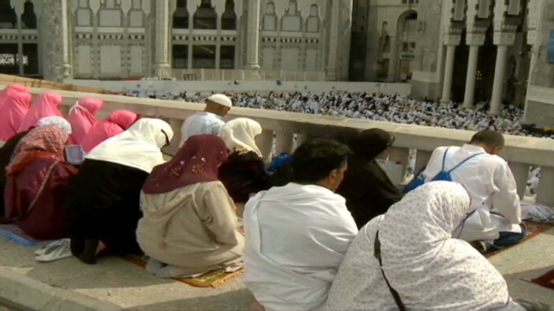
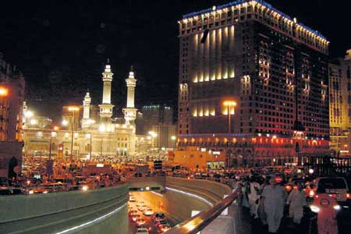
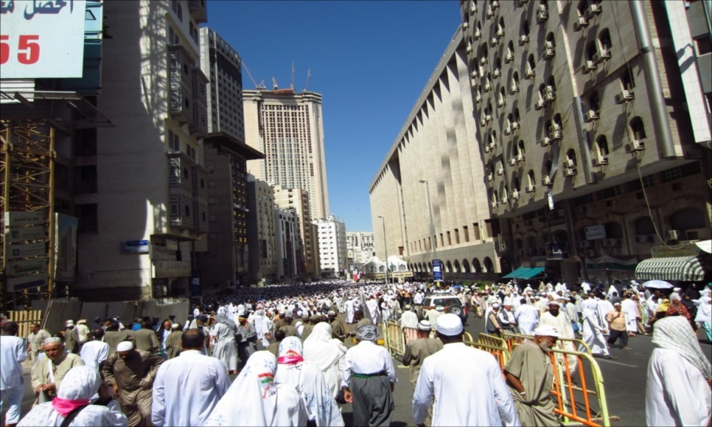
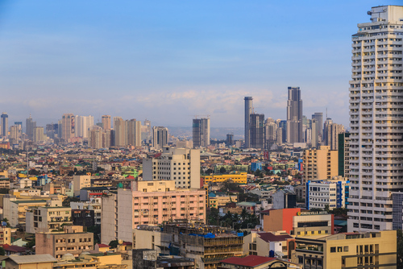
Trade and Towns

Slide 23
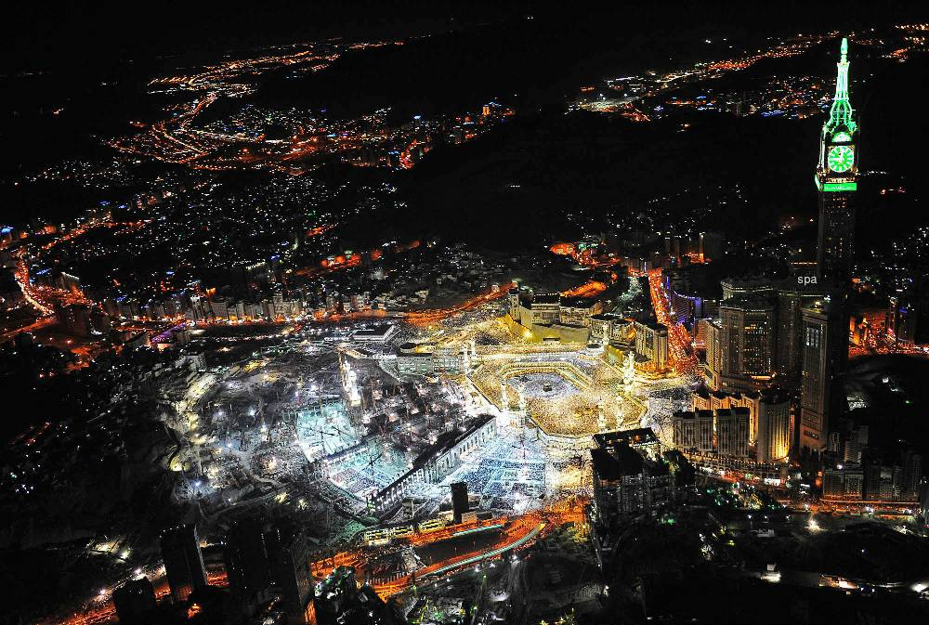
Trade and Towns

Slide 24
Trade and Towns
In the middle of mecca was the Kaaba, a low square building surrounded by statues of gods and goddesses.

Slide 25
Trade and Towns
Essentially the Kaaba is a granite brick, covered with a silk curtain and calligraphy in gold and silver-wrapped thread.
Arabs believed that the great stone inside the Kaaba was actually from heaven.

Slide 26
Trade and Towns
Pilgrims, or people who travel to a holy place, flocked to Mecca.
Arabians worship many gods, but the most important was Allah.

Slide 27
Trade and Towns
Allah is considered to be the creator of the world within the Islamic Religion.

Slide 28
Trade and Towns
Questions:
1) What is a caravan and how were they used in Arabia?
A group of merchants traveling from town to town
2) What was the most important town to be established in Arabia?
Mecca
3) What is the Kaaba and how is it important?
A great stone in Mecca, believed to be from heaven

Slide 29
Trade and Towns
Persuasive Writing:
Answer the following questions in a well organized and creative re open ended explanation.
Pretend that you are a Bedouin. What dangers lye ahead of you on your journey throughout the desert. What challenges do you have with raising your livestock in this environment? How can you create a safe trip for you and your animals?

